Slide 1
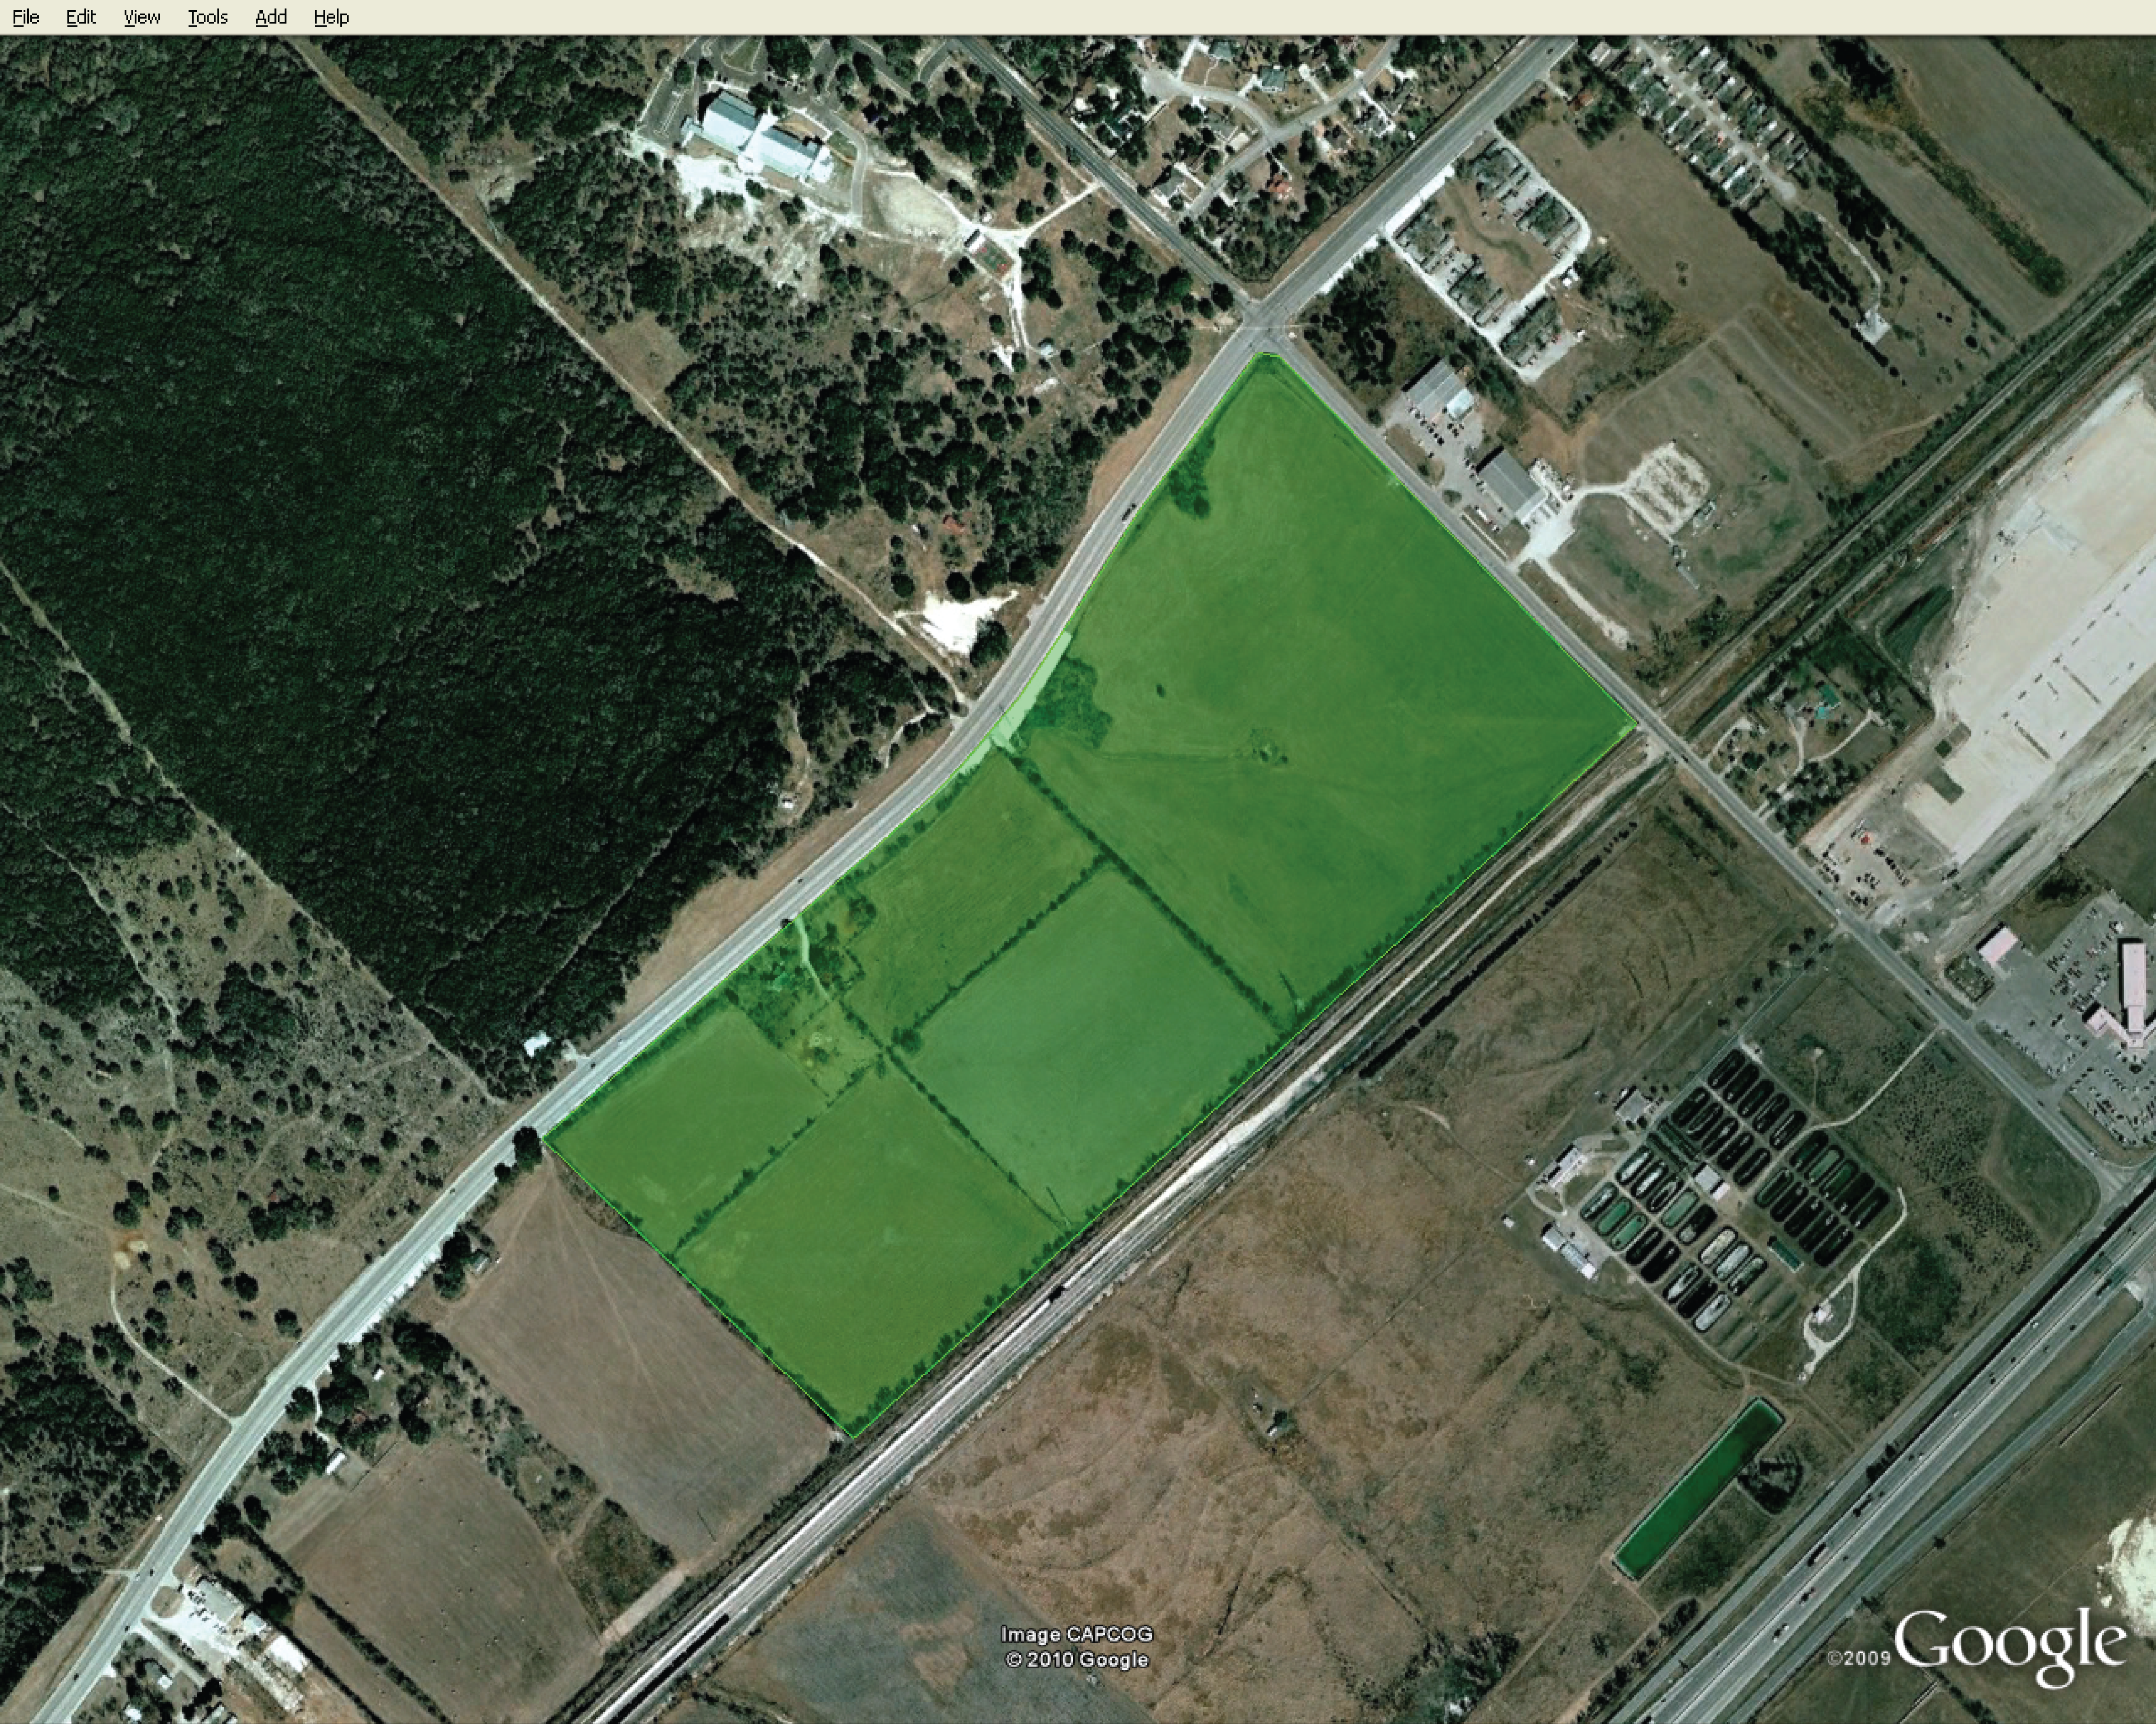
Texas STAR Park
GIS Concept Plan?
Evolved Geospatial Planning:
Marshal Brandt, Billy Cook, Chris Felker, Isaac Whitt

Slide 2



Project Background
Texas State is a developing research university
Construction of research park
The park will primarily contain research facilities and offices
Also, will contain university facilities

Slide 3
Work Completed
Hydrologic Analysis
Drainage System Design
Suitability Analysis
Conceptual Layout

Slide 4
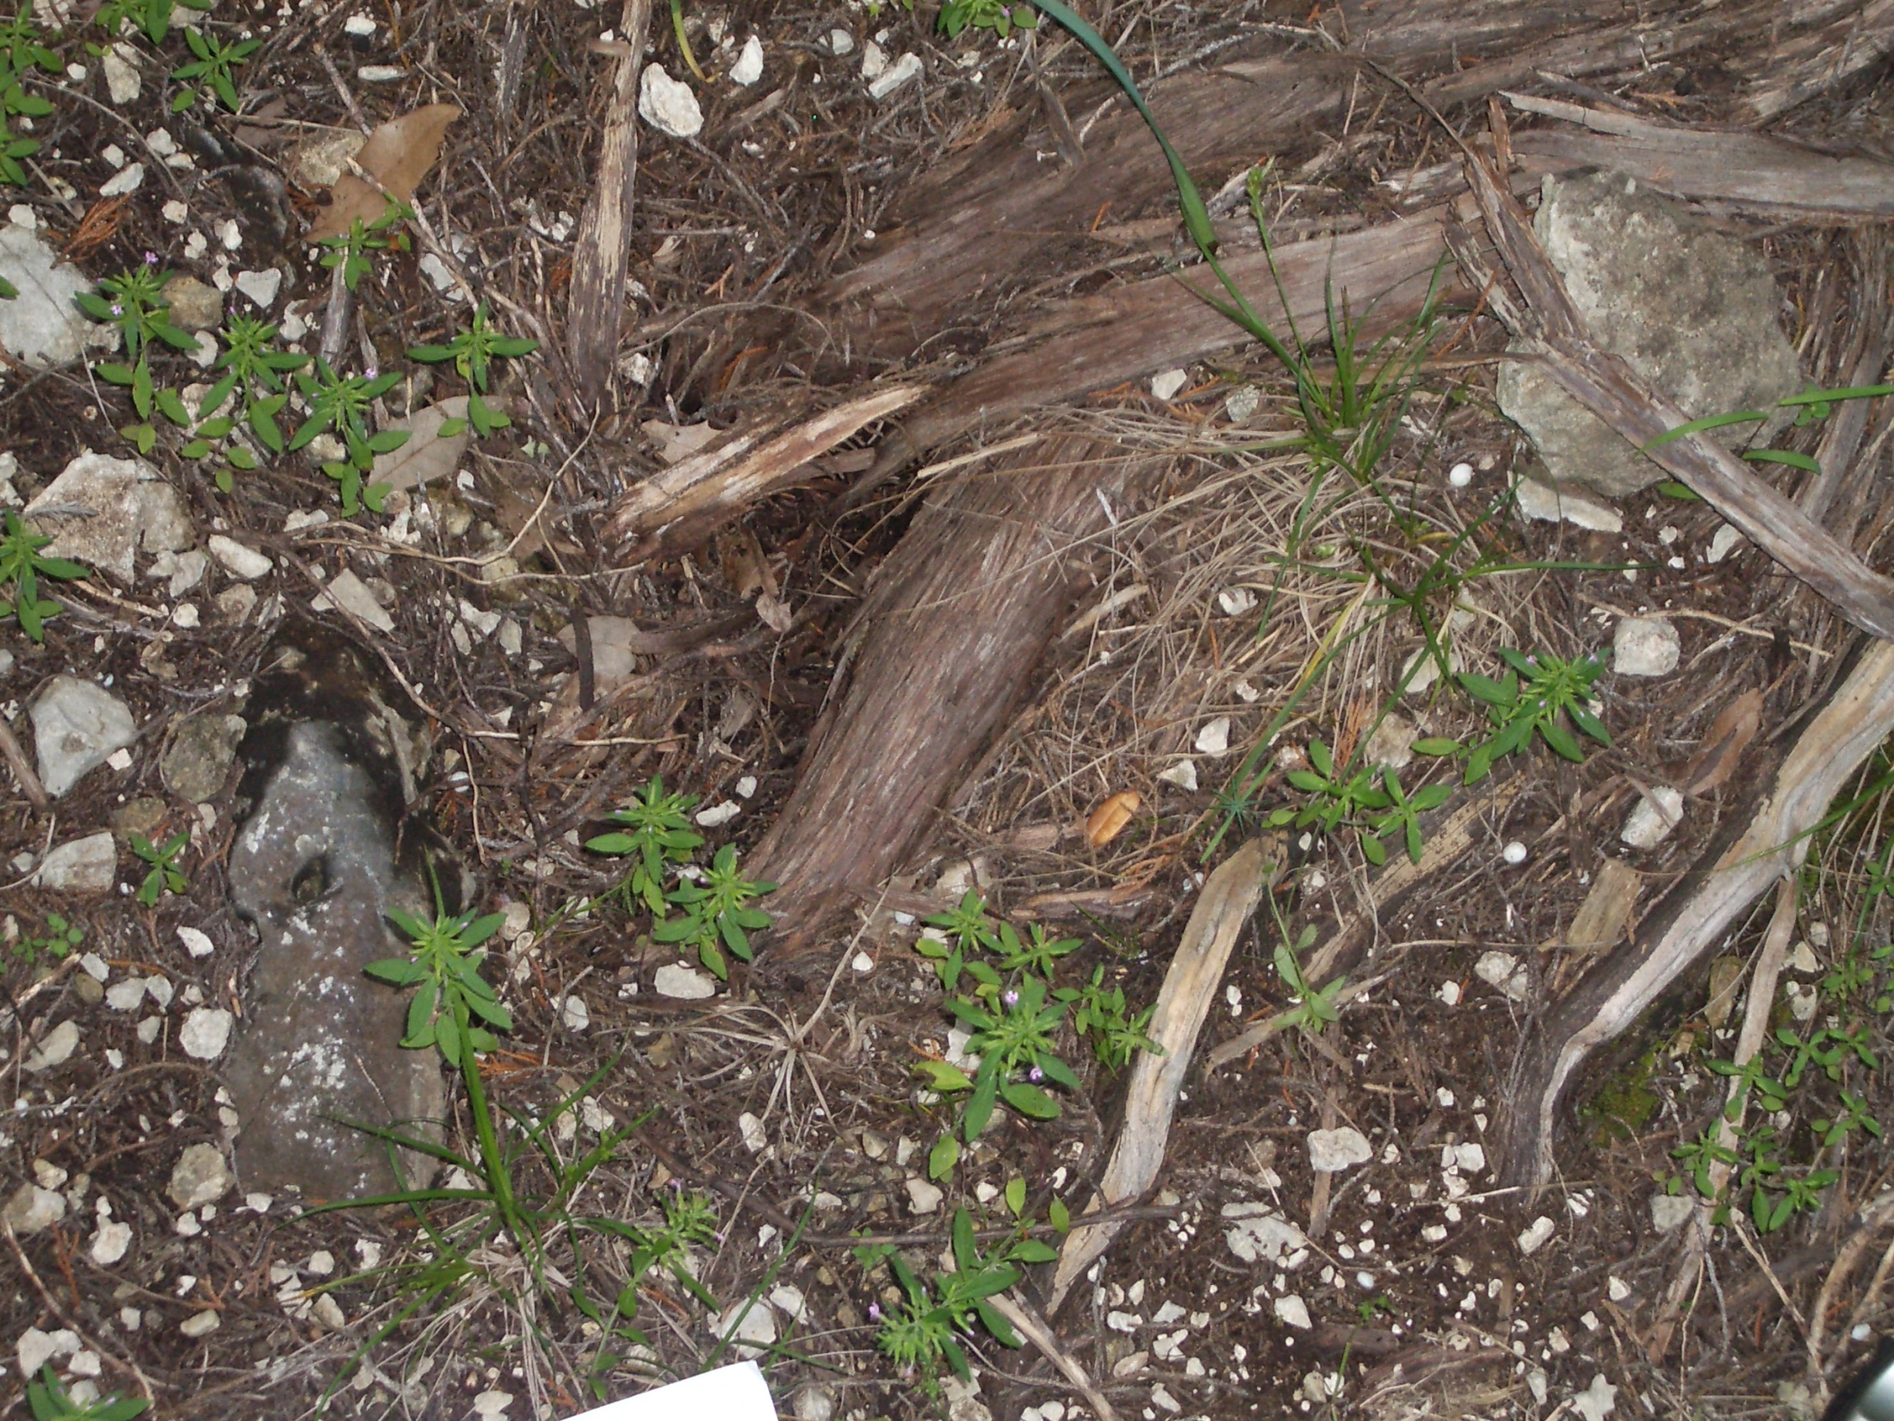
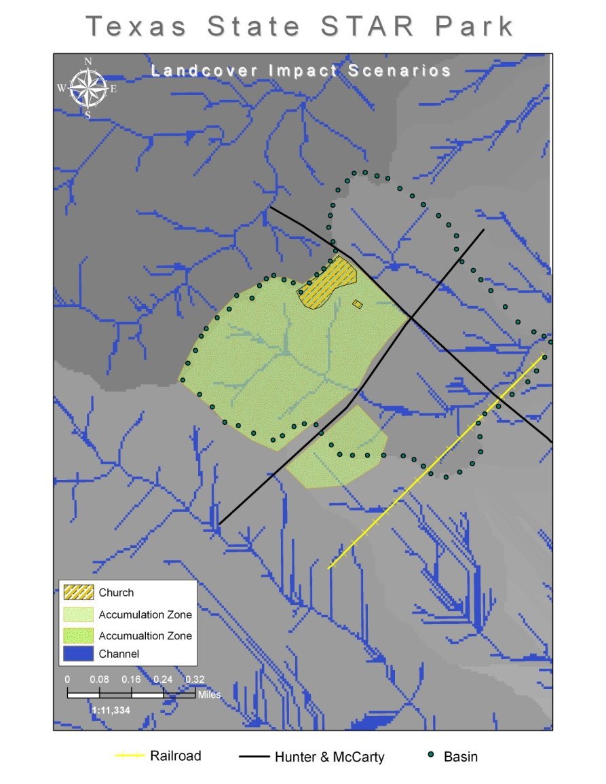
Work Completed
I. Hydrologic Analysis
Basin Delineation, Characteristics
V=CAR, Detention basin volume
Runoff Volume per Storm event

Slide 5
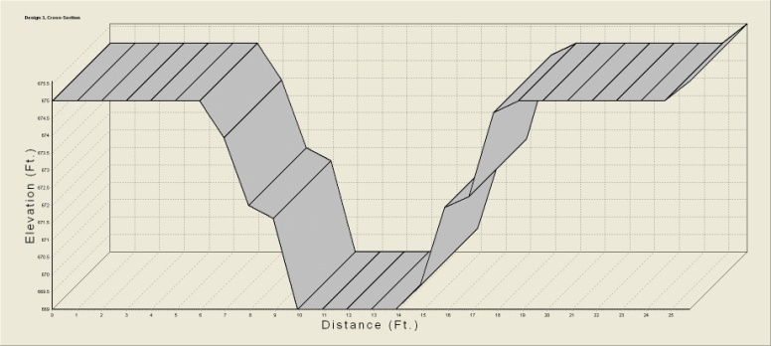
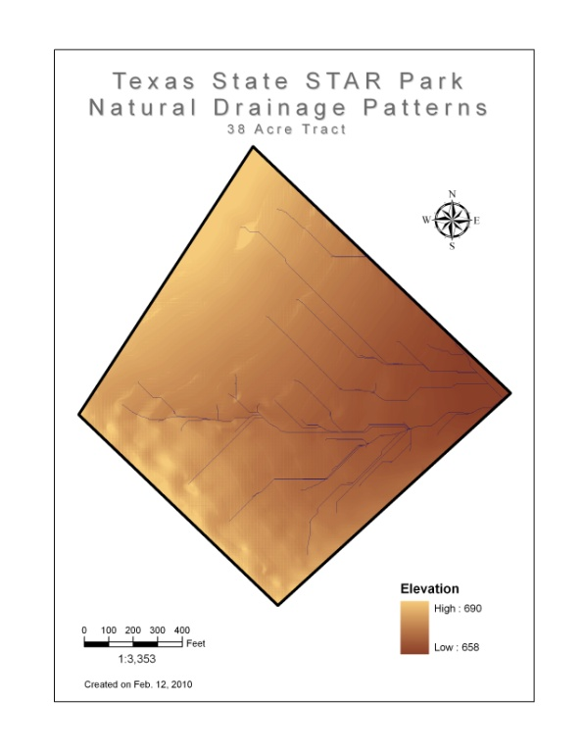
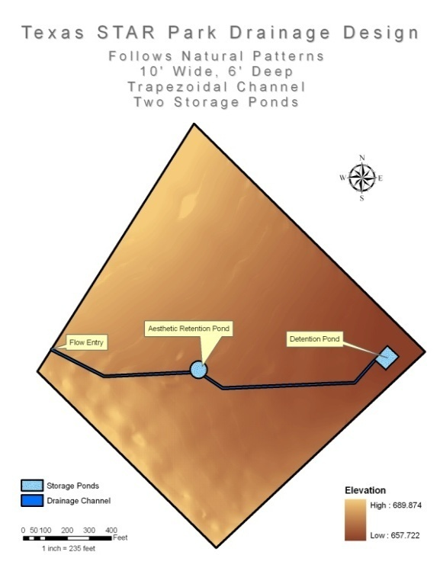
Work Completed
II. Drainage Design
Based on drainage analysis results
Utilize trapezoidal channel shape
Multiple designs created to allow cost and effectiveness comparisons
Volume of soil excavated
Volume of water capacity

Slide 6
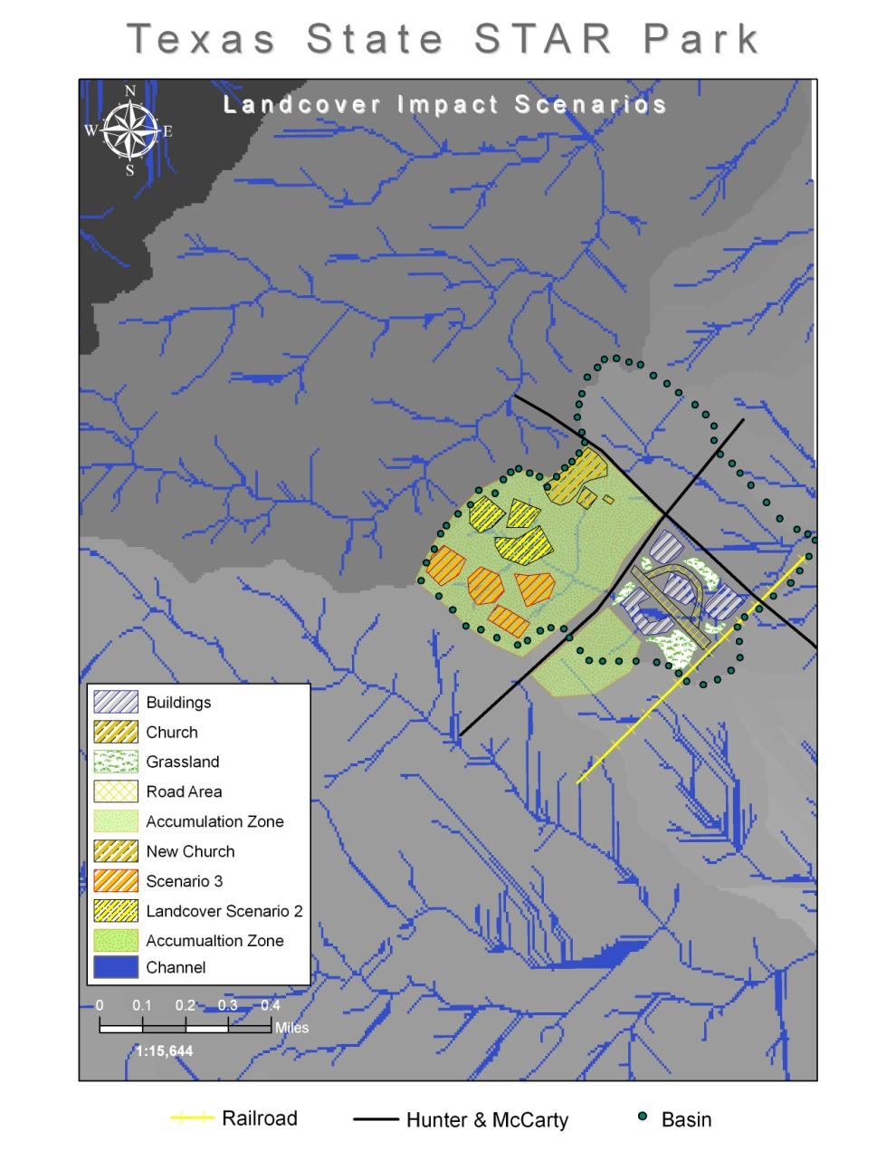
Finalized Drainage Analysis
Areas of Impervious surface
Land Cover change- Scenario break down
Scenario Outcomes

Slide 7
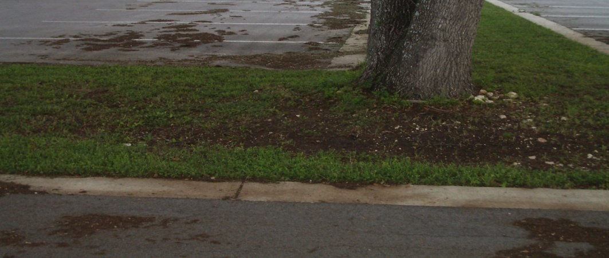
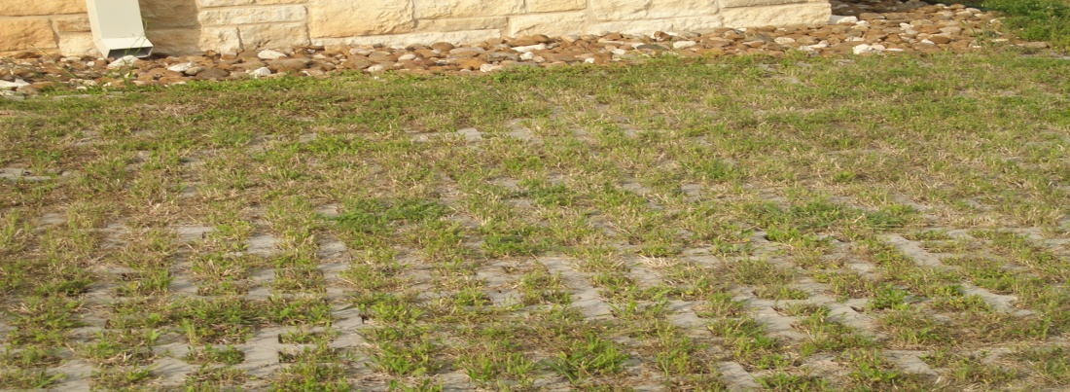
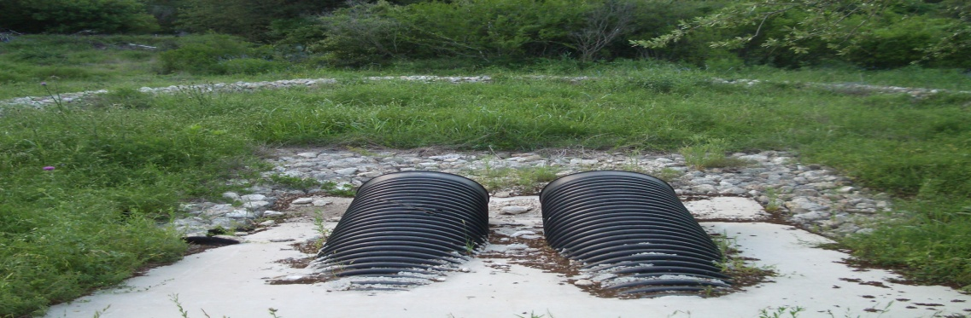
Infiltration recommendations
Porous Pavement
Eliminate curbs
Gutter into infiltration beds
Vegetated basins

Slide 8
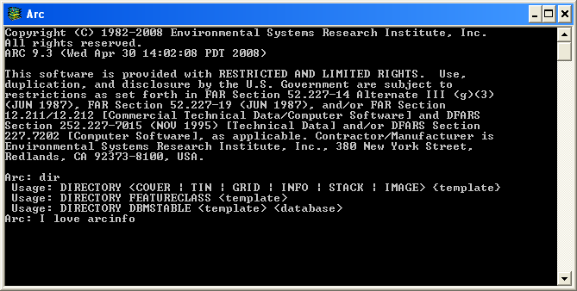
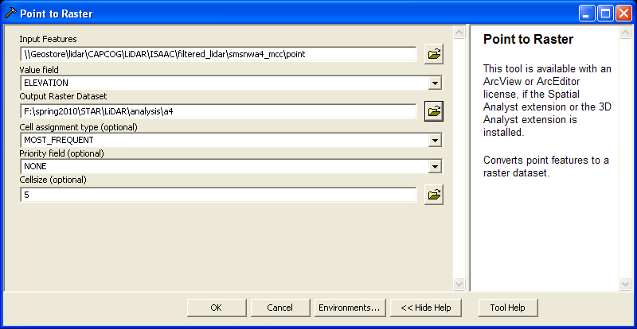
Work Completed
III. LiDAR Processing
Methodology
Filtering Algorithm
Conversion to Raster

Slide 9
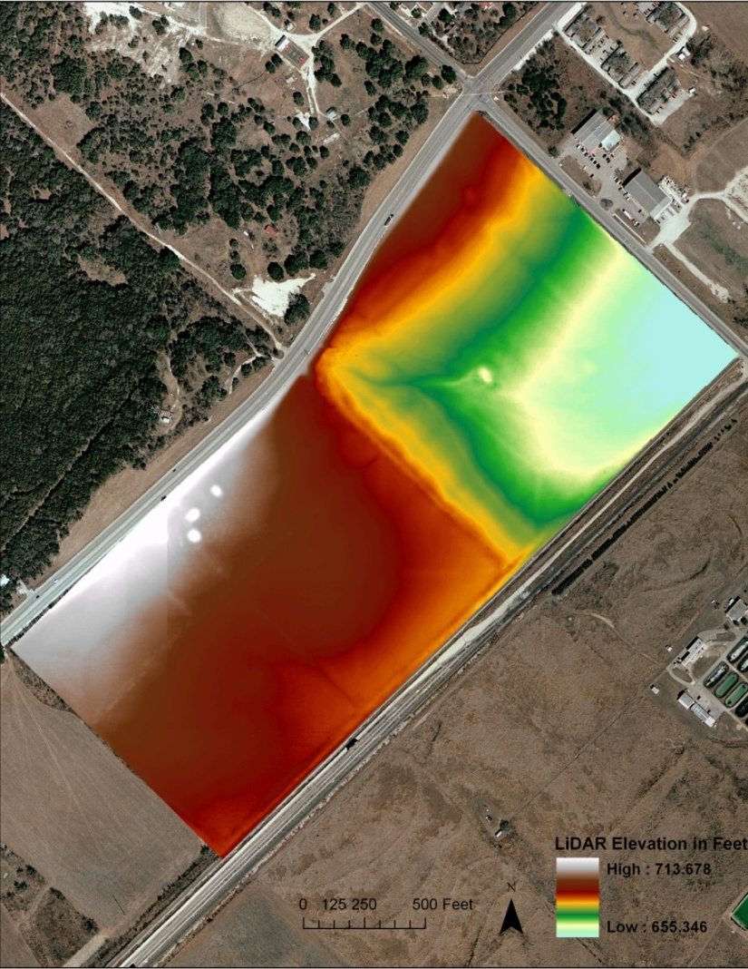
Work Completed
III. LiDAR Processing
The Final Product: Five Feet Resolution Elevation Data

Slide 10
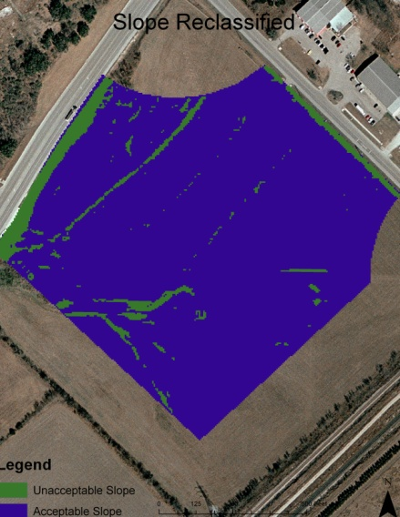
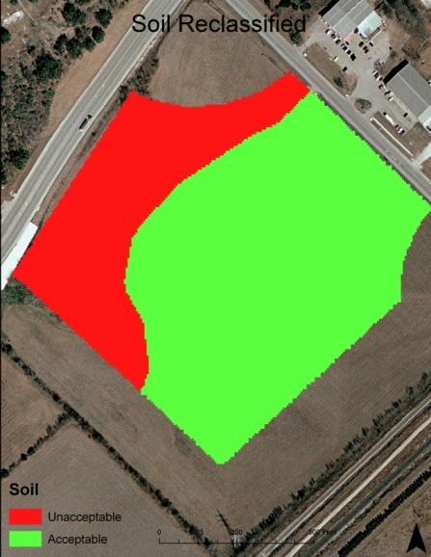
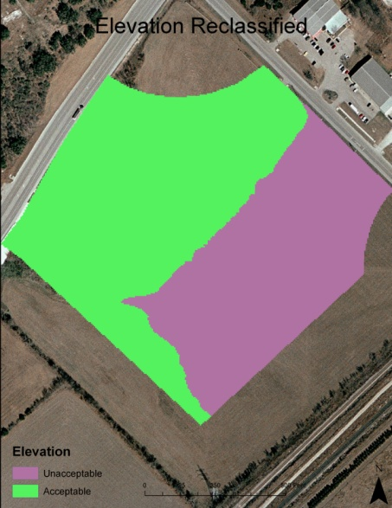
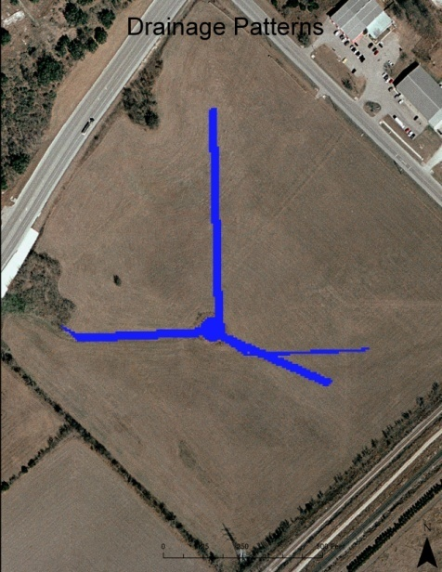
Work Completed
IV. Suitability Analysis
Building Types
Labs
Offices
Data Center
Methodology
Extract
Reclassify
Add Maps

Slide 11
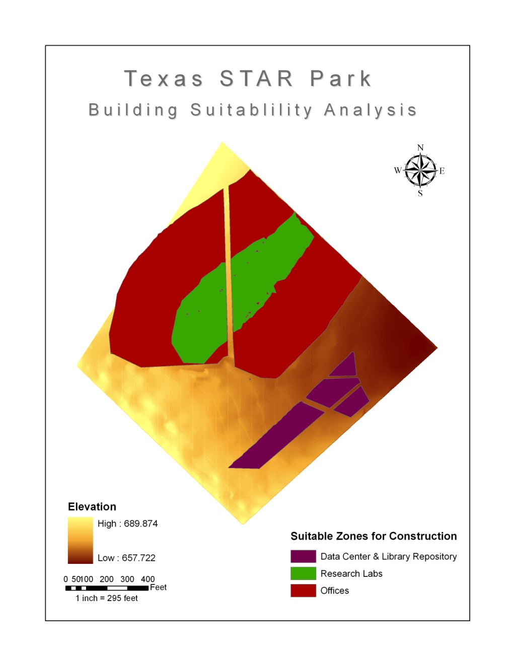
Work Completed
IV. Suitability Analysis
Result

Slide 12
Current Work
Layout Design
Finalize Drainage Analysis

Slide 13
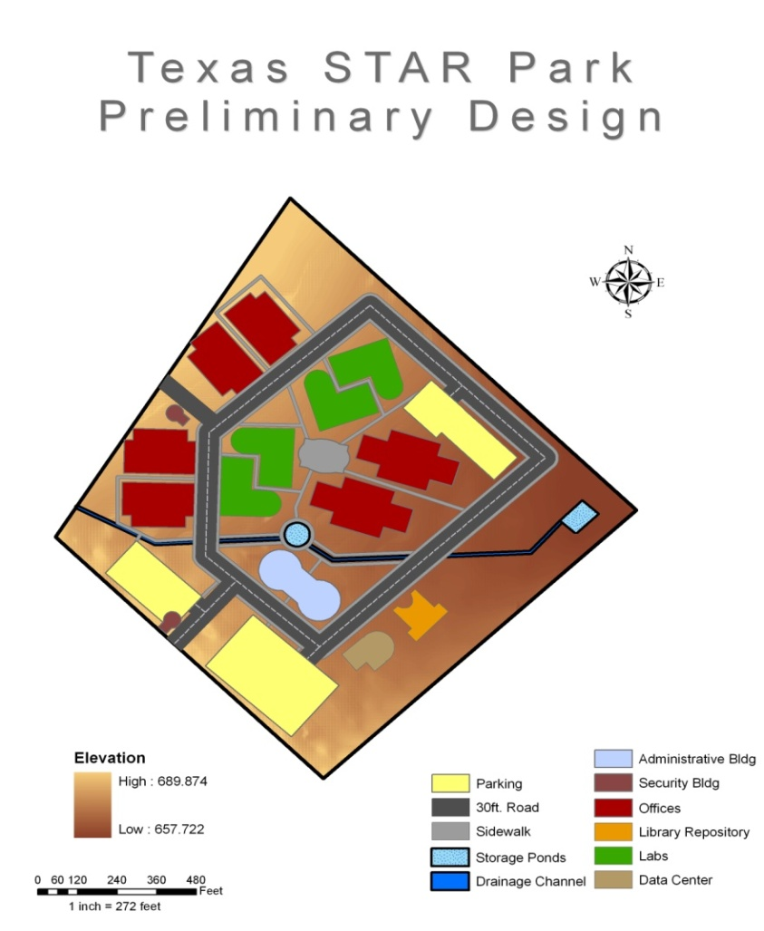
Current Work
I. Layout Design
Most efficient use of funds vs. space
Explore multiple design layouts
Number of buildings
Building orientation
and distribution

Slide 14
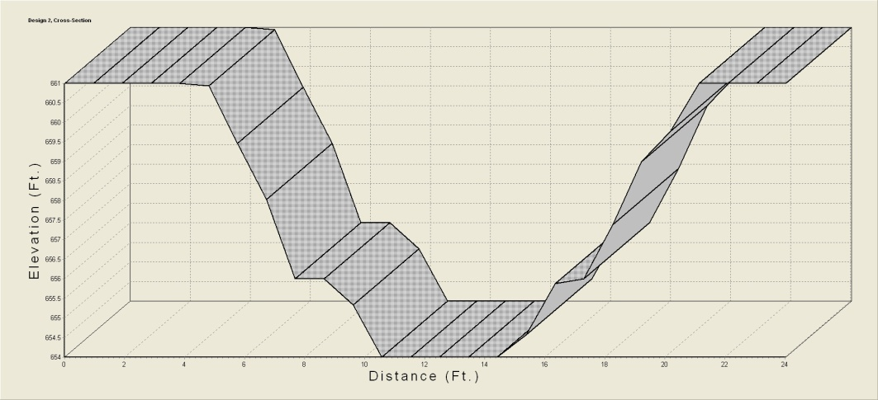
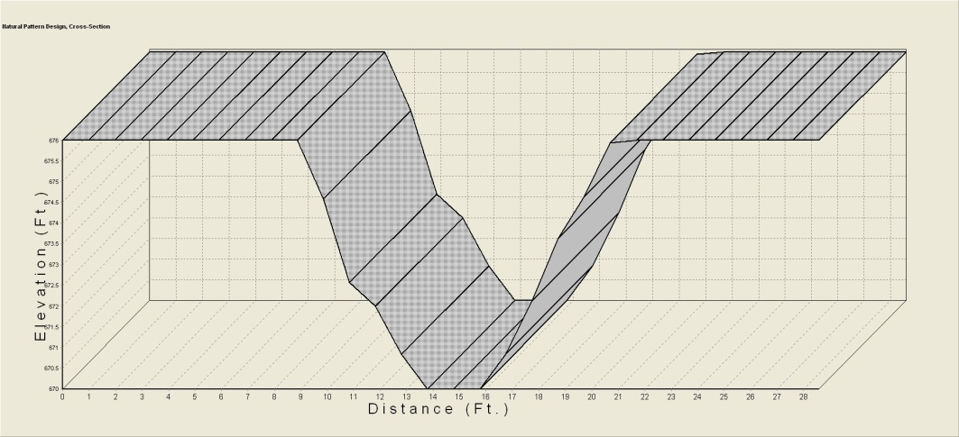
Future Work
I. Finalize Drainage Design
Based on results of local rainfall accumulation calculations
Ensure the design can support storm conditions
Calculate approximate cost of excavation

Slide 15
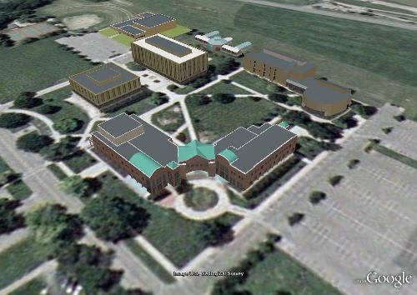
Future Work
II. Conceptual Visualizations
Google Sketchup
Produce 3D visual of the best design layout
Image from: http://sketchup.google.com/3dwarehouse/details?mid=20d45bc6c1e7bc30730618c907afc38a&prevstart=0

Slide 16
Conclusion
On schedule
Final product will deliver a scientifically derived drainage and layout design
“Under the guidance of E.G.P., Texas STAR Park will become a social research community that will produce a wealth of innovative products and concepts for years to come.”

